Slide 1
Online Quiz System by group 9
Kabir Selot 211P054 (37)
Mahira Fakih 211P058 (10)
Mariyum Siddique 211P023 (51)
Hamza Khan 211P021 (19)

Slide 2
Introduction
Online Quiz System (OQS), is a web based multiple-choice-question system; developed in MYSQL and PHP
It is a system that can be used by lecturers to evaluate students effectively, efficiently and perfectly.
Students are provided the flexibility to choose among different types of aptitude and programming language tests.
The questions vary student to student for the same quiz while they are sitting in the quiz at the same time.
.

Slide 3
Literature Survey
Online testing system represents a new paradigm in the world of information technology today.It is considered a fast developing examination method because of its accuracy and speed. It is also needed less manpower to handle the examination. Almost all organizations today, are managing their exams by online examination system, since it reduces student's time in examinations. Organizations can also easily monitor the progress of the student.The result is calculated in less time. It also helps diminishing the need for paper.

Slide 4
Problem Statement
The traditional way of exams have many drawbacks such as time consuming, Difficulty of analysing the test manually
More observers are required to take exam of many students, Results are not accurate since calculations is done manually.
The chance of losing exam's result is higher
Checking of result is time consuming since it is done manually, Limitation of no of student that can give examination at a time.

Slide 5
Objective and purpose
We have designed this website with the purpose of allowing the students to give exams and view their results instantly.
This site is an attempt to remove the existing flaws in the manual system of conducting exams.
The purpose of Online Quiz System is to save lecturer's time since the answers are automatically marked.
User-friendly system.

Slide 6
programming languages used
3
Database
1
FrontEnd
MySQL
2
BackEnd
Softwares
HTML
JavaScript
VS Code
XAMPP
PHP

Slide 7
Dataflow
Diagrams
LEVEL 0:
USER
ADMIN USER
REGISTERED USER
Stores Questions and answers
Gives Test

Slide 8
Level 01:
Registered User
Gives test
User’s Data
TEST PROCESS
Verify answers
Test Evaluation

Slide 9
Level 02:
Question Bank
Checks answers from database
Test Evaluation
Calculate Result
Share Result

Slide 10
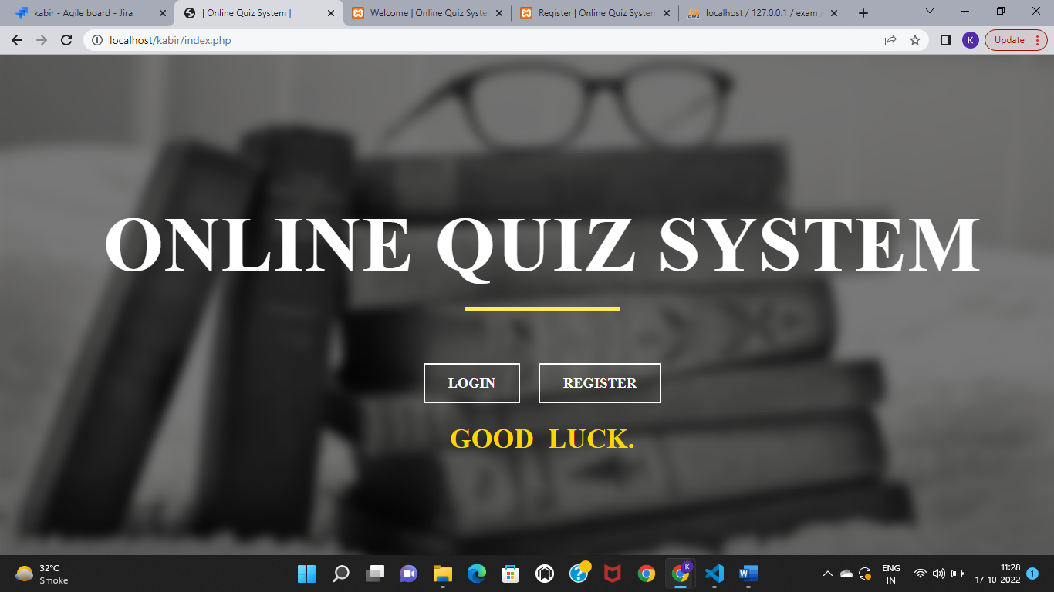
Implementation

Slide 11
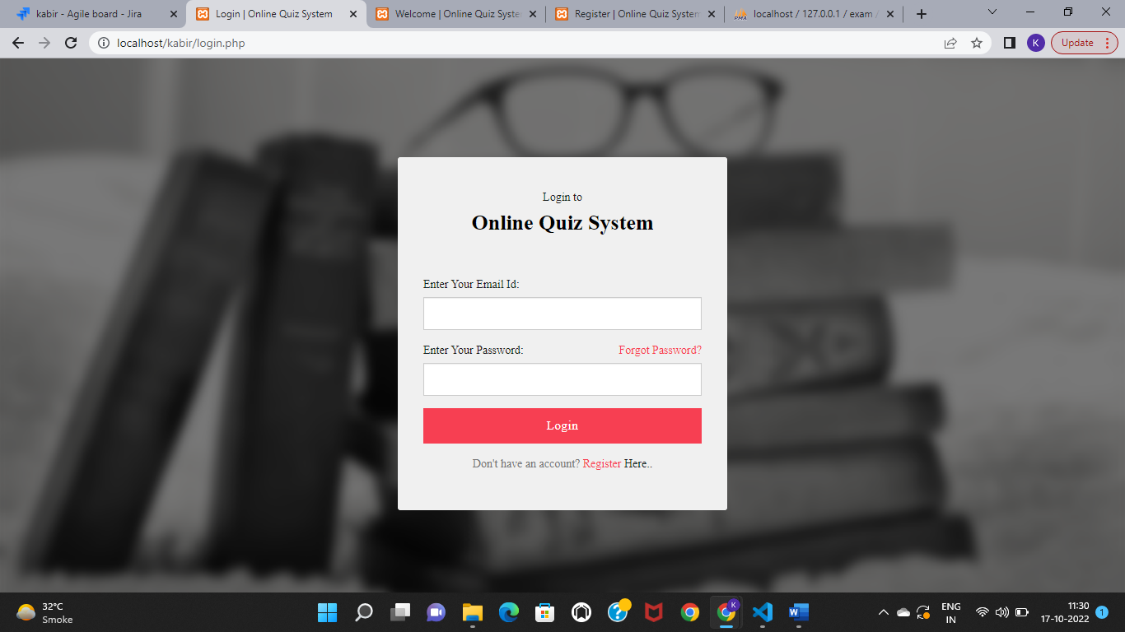

Slide 12
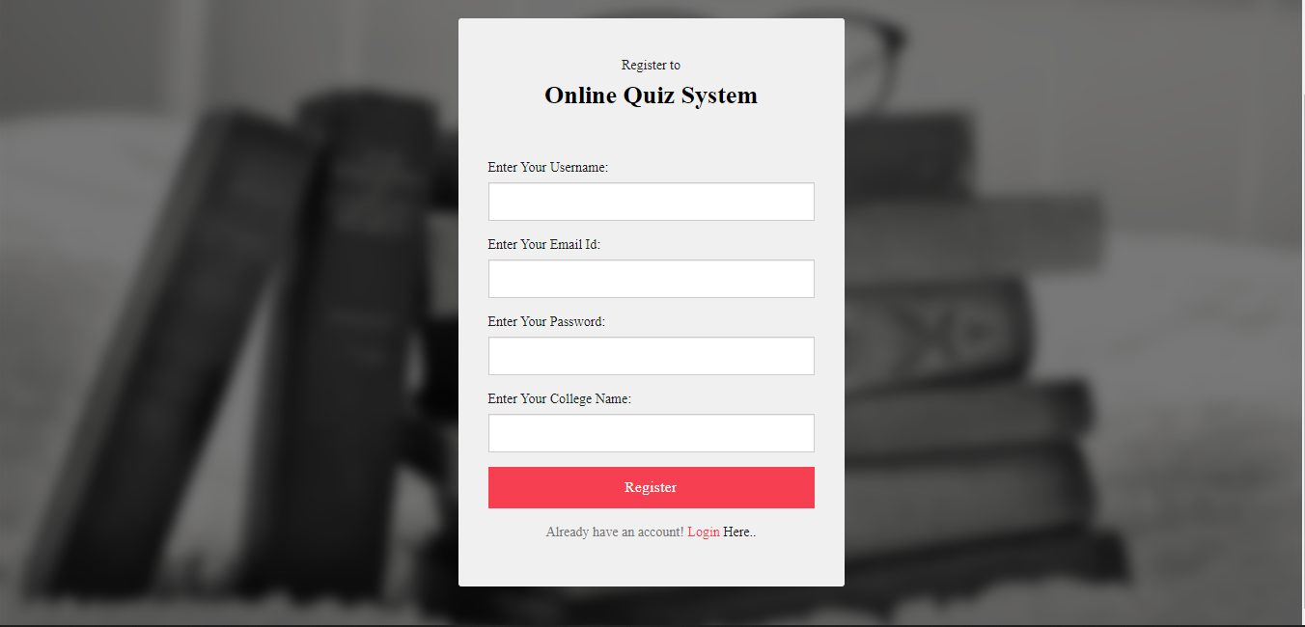

Slide 13
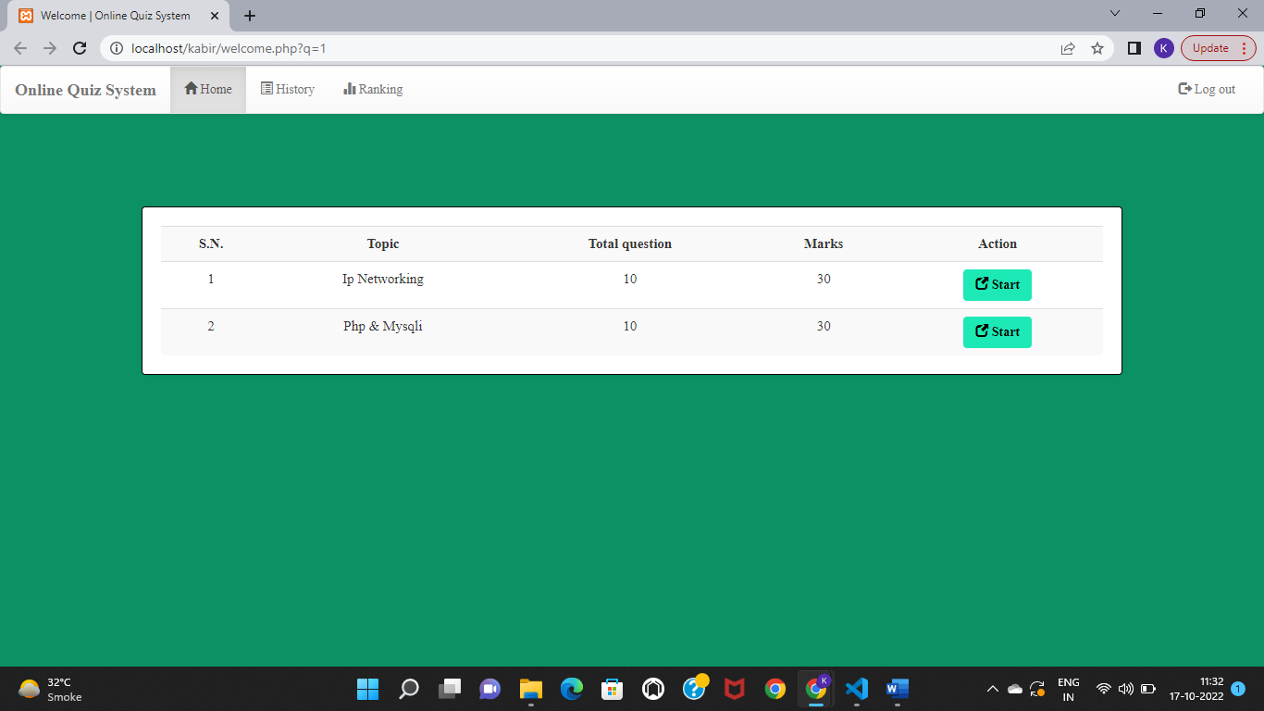

Slide 14
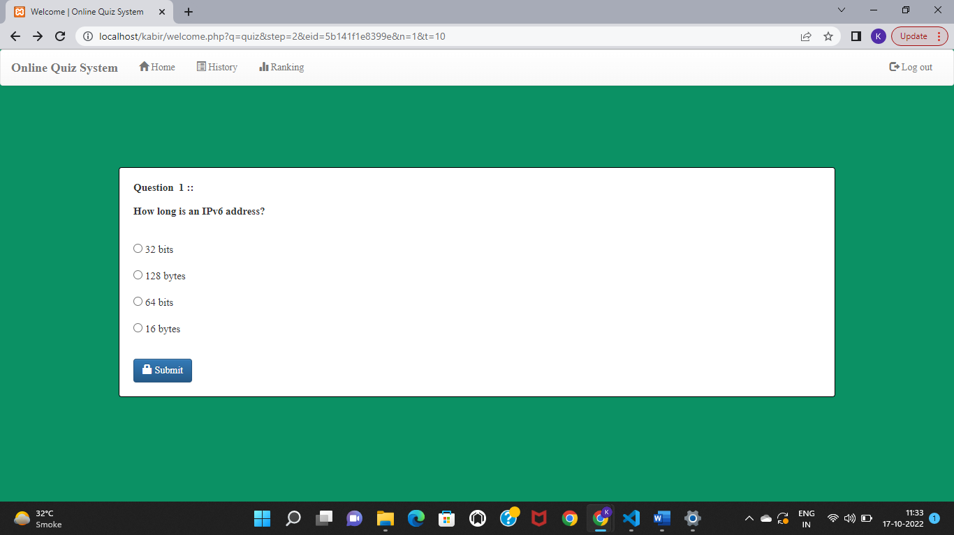
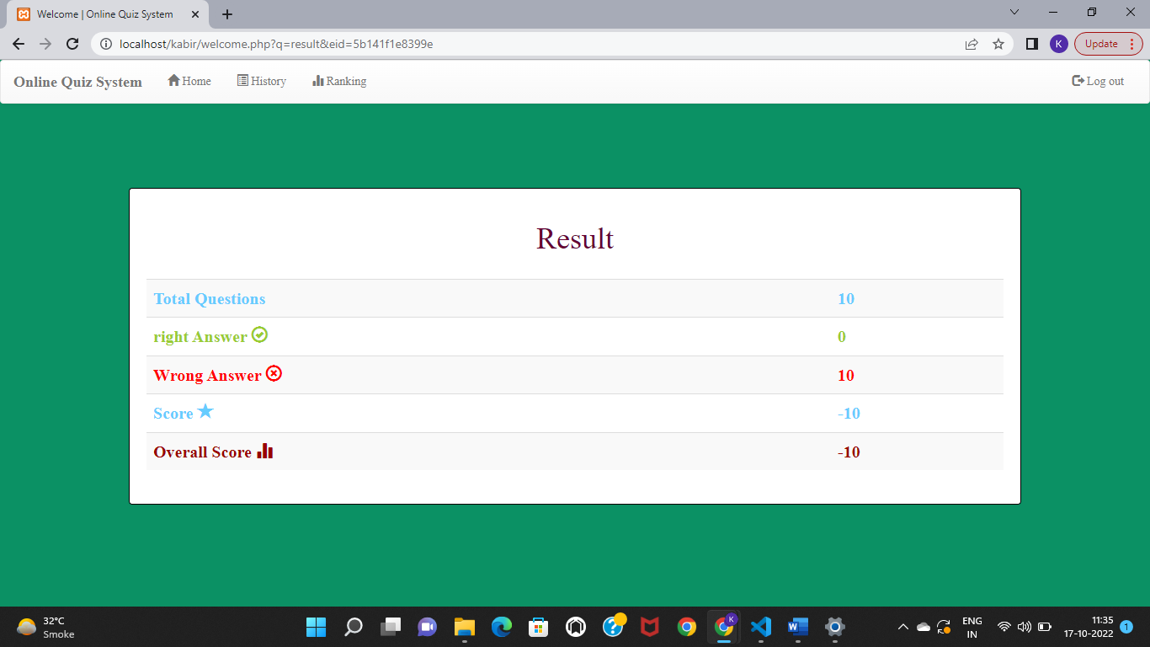

Slide 15
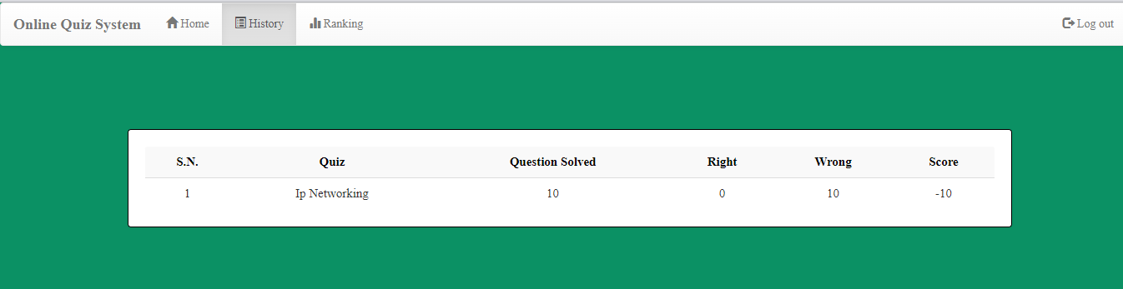
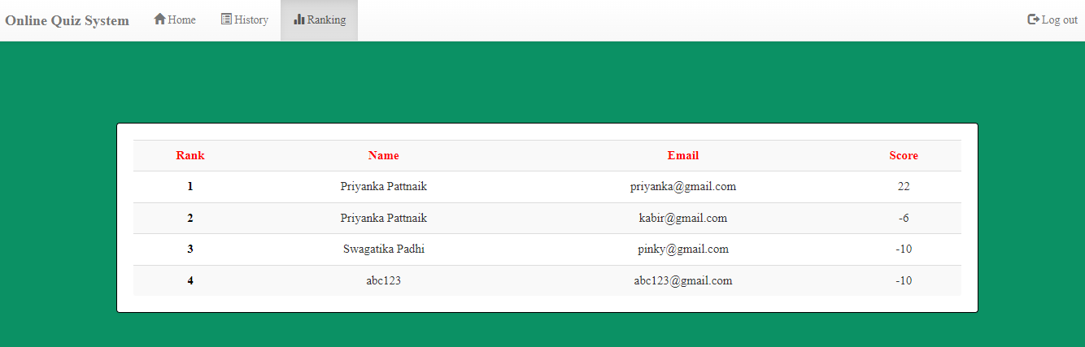

Slide 16
Features:
Easy to sign in and sign up.
It consists of different types of multiple choice questions.
Immediately result is presented after the test.
Students can see their results anytime.
Password will be stored in the database in the encrypted form.
The questions vary student to student for the same quiz.
For lecturer, lecturer can add question, schedule quiz and manage their class for their subject.

Slide 17
In Conclusion
Online Quiz System has three main users who are admin/lecturer and student. For the admin/lecturer, he can manage student. For the student, student must login in the system, answer quiz and get the result of their quiz.
This kind of system can replace the manual system in order to increase the efficiency of the quiz management. In the future, there are still a lot features that can be added into this system. Firstly, the pagination function should be built for a better and friendly view of users towards this system. Next, every process of entering data into system needs to have an efficient and accurate verification process .

Slide 18
thank you
by
Kabir Selot
Mahira Fakih
Mariyum Siddique
Hamza Khan

